Slide 1
Charts and Statistical Visualization
Debajyoti Mondal
University of Saskatchewan

Slide 2
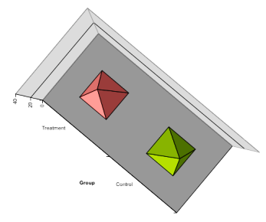
Example of Bad Visualizations

Slide 3
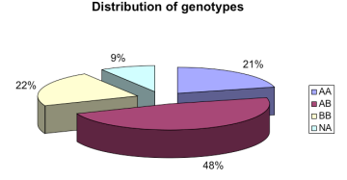
Example of Bad Visualizations

Slide 4
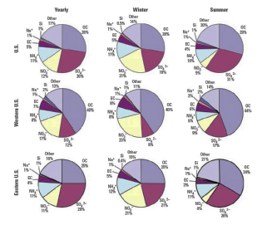
Example of Bad Visualizations

Slide 5
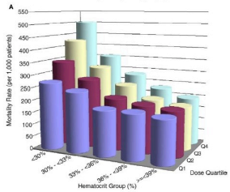
Example of Bad Visualizations

Slide 6
Bar Chart
What are the problems with this graph?
Curtsey: STA6166-2-6

Slide 7
Bar Chart
Sorting and expanding the scale of the graph allows all labels to be seen as well as displaying a characteristic of the data.
Curtsey: STA6166-2-7

Slide 8
Bar Chart
A vertical display allows better comparison of calorie amounts.
Curtsey: STA6166-2-8

Slide 9
Histogram
One axis representing the range of the variable, and the other axis representing the data density at positions within the range
Most commonly-used for univariate data
For relatively continuous data, observations are grouped into mutually exclusive categories, called “bins”
Used to visualize distribution (shape, center, range, variation)
A major challenge is to come up with an appropriate binning process

Slide 10
Frequency Histogram
A graphical presentation of the frequency table where the relative areas/height of the bars are in proportion to the frequencies.
9
8
7
Frequency
y
6
c
n
5
e
u
q
e
4
r
F
3
2
1
0
0
5
0
1
0
0
1
5
0
2
0
0
Bin width
c
a
l
o
r
i
e
s

Slide 11
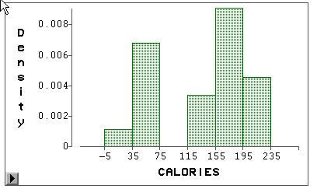
Density Histogram
A density histogram (or simply a histogram) is constructed just like a frequency histogram, but now the total area of the bars sums to one.
This is accomplished by rescaling the vertical axis. Instead of frequencies, the vertical axis records the rescaled value of the density.
Histograms have important ties to probability.
Sum of shaded area is equal to one.

Slide 12
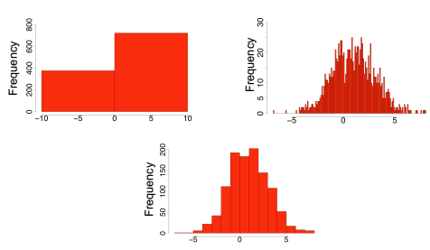
Number of Bins for Histograms
How we view the “distribution” of a dataset can depend on how much data we have and how it is binned.

Slide 13
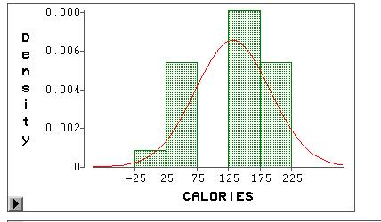
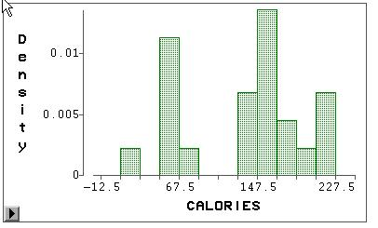
Number of Bins for Histograms
Smoothed histogram or density curve
Six bins
Five bins
Eleven bins
How we view the “distribution” of a dataset can depend on how much data we have and how it is binned.

Slide 14
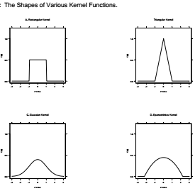
Smoothed Histogram
A continuous function of the original data values
Construction of a smoothed histogram requires a kernel function
Triangular
Rectangular
Gaussian
Epanechinkov

Slide 15
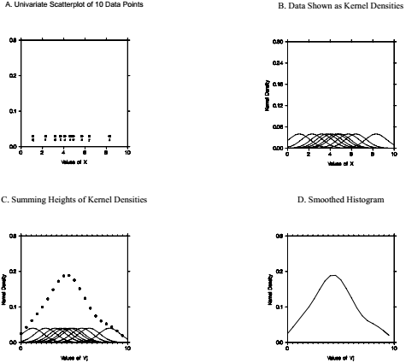
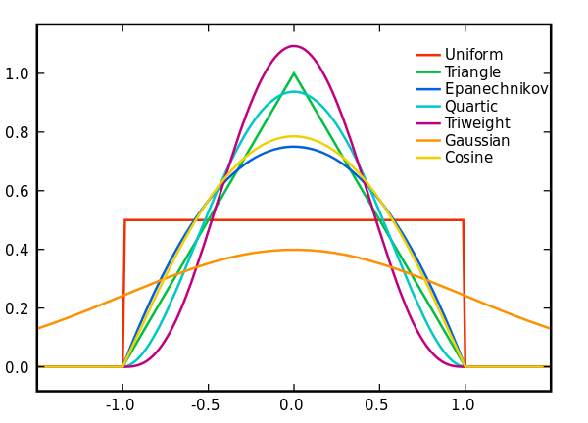
Smoothed Histogram
https://en.wikipedia.org/wiki/Kernel_(statistics)#Kernel_functions_in_common_use

Slide 16
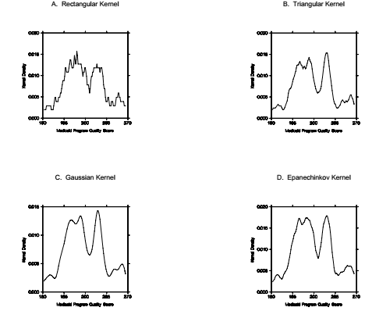
Smoothed Histogram
Notes:
Useful for electric pulse or medical or scientific signal

Slide 17
To effectively use charts we need to know some statistics

Slide 18
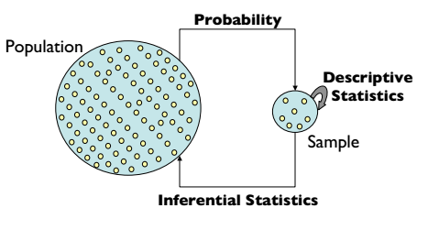
“Central Dogma” of Statistics

Slide 19
Basic Statistics
A statistic is a function of the sample data.
We will learn some “descriptive statistics”. These statistics address specific aspects of the distribution of the data.
What is the range of the data?
When we sort the data, what number might we see in the “middle” of the range of values?
What number tells us over what sub-range do we find the bulk of the data ?

Slide 20
Extremes
If we sort the data we can immediately identify the extremes.
Extremes
Minimum(calories) = 10
Maximum(calories) = 210
The minimum and maximum are “statistics”.

Slide 21
Range
Range: the difference between the largest and smallest measurements of a variable.
Extremes
Minimum(calories) = 10
Maximum(calories) = 210
Range = 210-10 = 200
Tells us something about the spread of the data.

Slide 22
Range
Range: the difference between the largest and smallest measurements of a variable.
Extremes
Minimum(calories) = 10
Maximum(calories) = 210
Range = 210-10 = 200
Tells us something about the spread of the data.
Midrange = minimum + (Range/2)
=10 + 200/2
=110
Is it a “good” measure of the center of the data?

Slide 23
Measures of Central Tendency
Estimate the value that is in the center of the “distribution” of the data .
Median = middle value in the sorted list of n numbers: at position (n+1)/2
= unique value at (n+1)/2 if n is an odd number or
= average of the values at n/2 and n/2+1 if n is even
= (160 + 160)/2 = 160

Slide 24
Measures of Central Tendency
Estimate the value that is in the center of the “distribution” of the data .
Mean = sum of all values divided by number of values (average)
= (10 + 60 + 60 + 60 + … + 210 + 210)/22
= 133.6
Trimmed mean = mean of data where some fraction of the smallest and largest data values are not considered. Usually the smallest 5% and largest 5% values (rounded to nearest integer) of data are removed for this computation.
= 136.0 (with 10% trimmed, 5% each tail).

Slide 25
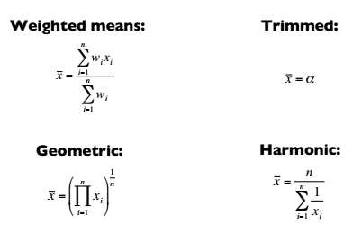
Measures of Central Tendency
Estimate the value that is in the center of the “distribution” of the data .
Other Types

Slide 26
Variance and Standard Deviation
Variance: The sum of squared deviations of measurements from their mean divided by n-1.
Sample Mean
Standard Deviation: The square root of the variance.
These measure the spread of the data.

Slide 27
Why squared deviation?
Which one is correct?
Square is not necessary - taking absolute values would also work
Squares are necessary because we divide by (n-1) instead of n
Square increases the contribution to the variance is as you go farther from the mean.
Any power of value at least 2 works, but square works best

Slide 28
Why Standard Deviation?

Slide 29
Why Standard Deviation?
Variance is somewhat arbitrary, But if you “standardize” that value, you could talk about any variance (i.e. deviation) in equivalent terms
Square root – now the value is in the units we started with

Slide 30
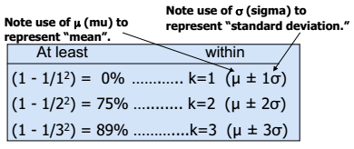
Why Standard Deviation?
Variance is somewhat arbitrary, But if you “standardize” that value, you could talk about any variance (i.e. deviation) in equivalent terms
Regardless of how the data are distributed, a certain percentage of values must fall within k standard deviations from the mean:
Courtesy: Joshua Akey

Slide 31
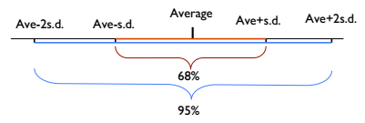
Often We Can Do Better
For many lists of observations – especially if their histogram is bell-shaped
Roughly 68% of the observations lie within 1 standard deviation of the average
95% of the observations lie within 2 standard deviations of the average
Courtesy: Joshua Akey

Slide 32
Quartiles
Suppose we divide the sorted data into four equal parts. The values which separate the four parts are known as the quartiles.
Because the sample size, does not always divide easily by 4, we do some estimating of these quartiles by linear interpolation between values.
Here n=22, (n+1)/4=23/4=5.75, hence Q1 is three quarters between the 5th and 6th observations in the sorted list. The 5th value is 60 and the 6th value is 60, thus
Q1 = 60 + .75(60-60)=60.
For Q2, (n+1)/2 = 23/2 = 11.5, e.g. half way between the 11th and 12th obs.
Q2 = 160 + .5(160-160) = 160.
For Q3, 3(n+1)/4 = 3(23)/4 = 69/4 = 17.25, a quarter of the way between the 17th and 18th observations.
Q3 = 180 + .25(180-180) = 180

Slide 33
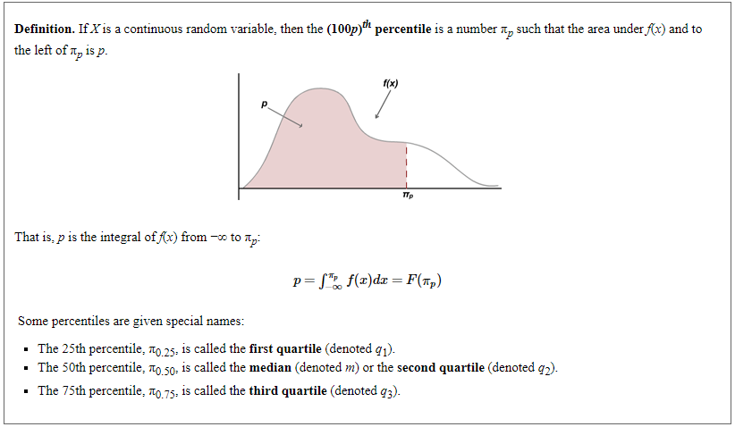
Percentiles
We assign these detailed calculations
to software packages…

Slide 34
Interquartile Range (IQR)
Difference between the third quartile (Q3) and the first quartile (Q1).
Quartiles:
Q1 = 25th = 60
Q2 = 50th = median = 160
Q3 = 75th = 180
IQR = Q3-Q1 = 180 - 60 = 120
The first quartile, Q1, is the value for which 25% of the observations are smaller and 75% are larger
Q2 is the same as the median (50% are smaller, 50% are larger)
Only 25% of the observations are greater than the third quartile

Slide 35
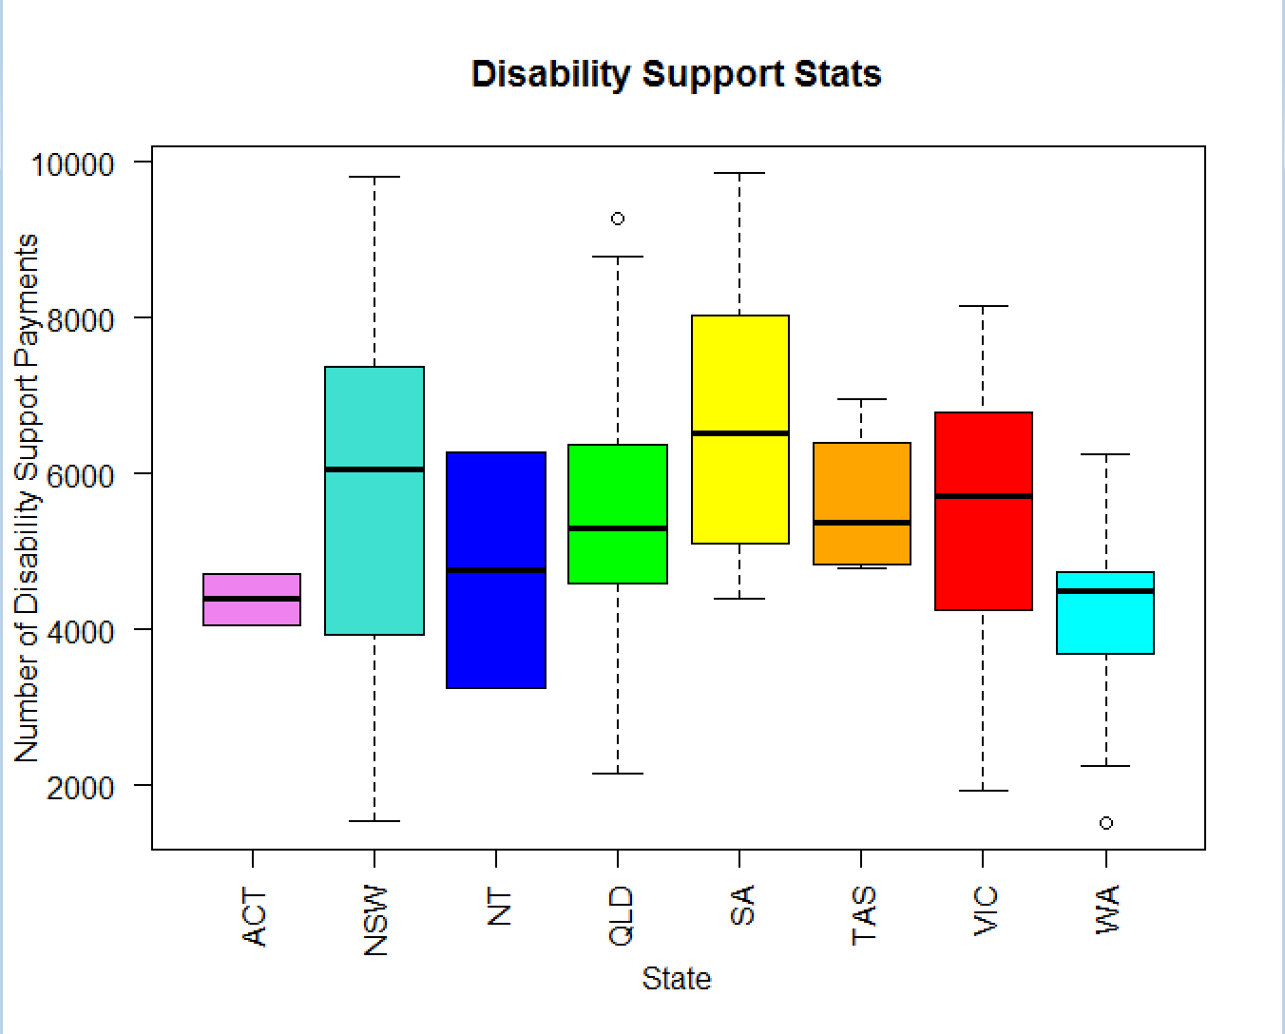
Ready for Box Plots!
John Tukey - 1977

Slide 36
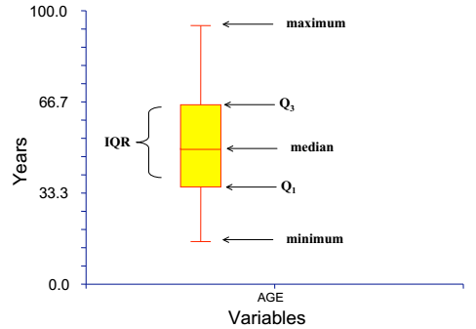
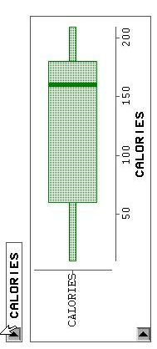
Box Plot for Calories
A visualization of most of the basic statistics.

